Slide 1
Programming Example— Incremental Development
Top–down development, a concept inherent to modular programming, allows us to develop programs incrementally. By writing and debugging each function separately, we are able to solve the program in smaller steps, making the whole process easier.
First Increment: main and getData
Second Increment: add
Final Increment: Print ResultsThe

Slide 2
Modularity
Subtasks captured by Modules of program
Should be able to design, code, test each module independently

Slide 3
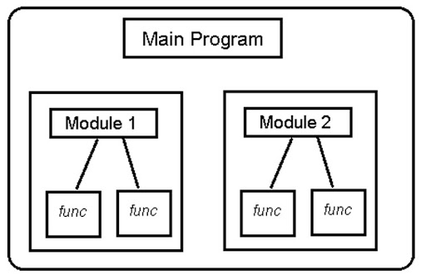
Modular programming

Slide 4
Structured Programming
Structured programs lend themselves to Bottom-Up Testing
Large programs can be written by teams

Slide 5
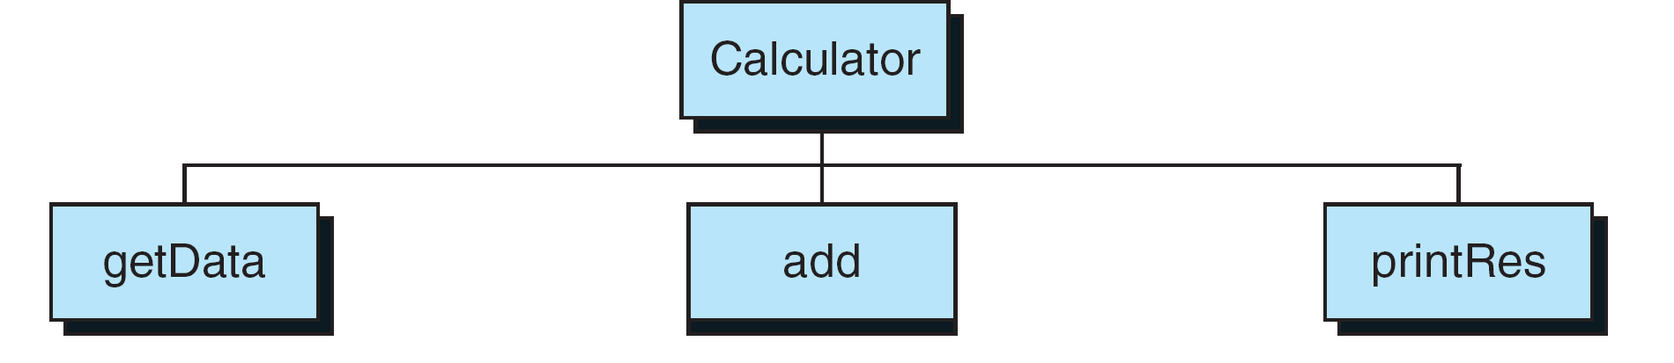
FIGURE 4-33 Calculator Program Design

Slide 6
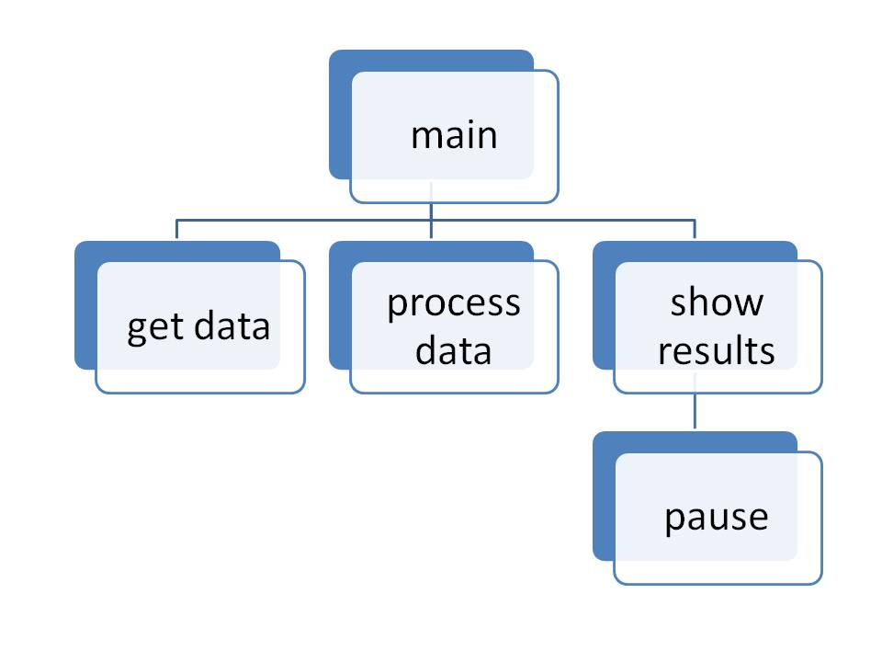
Functional Decomposition (Factoring)

Slide 7
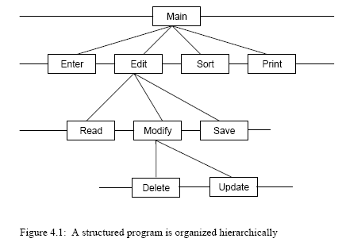

Slide 8
Unstructured Program
int main( void ) {
/* Get data from user */
statement1;
statement2;
statement3;
/* Perform computations */
statement4;
statement5;
statement6;
statement7;
/* Print results */
statement8;
statement9;
}

Slide 9
Structured Programming
Keep the flow of control in a program as simple as possible.
Use top-down design.
Keep decomposing (also known as factoring) a problem into smaller problems until you have a collection of small problems that you can easily solve.

Slide 10
Top-Down Design Using Functions
C programs normally consist of a collection of user-defined functions.
Each function solves one of the small problems obtained using top-down design.
Functions call or invoke other functions as needed.

Slide 11
Function Definitions, Prototypes, and Calls
#include <stdio.h>
void prn_message(void); /* function prototype */
/* tells the compiler that this */
/* function takes no arguments */
int main(void) /* and returns no value. */
{
prn_message(); /* function invocation */
}
void prn_message(void) /* function definition */
{
printf(“A message for you: “);
printf(“Have a nice day!\n”);
}

Slide 12
Form of a Function Definition
type function_name ( parameter type list )
{
declarations
statements
}
Some Terminology
Header: Everything before the first brace.
Body: Everything between the braces.
Type: Type of the value returned by the function.
Parameter List: A list of identifiers that provide information
for use within the body of the function.
Also called formal parameters.

Slide 13
The return Statement
When a return statement is executed, program control is immediately passed back to the calling environment.
If an expression follows the keyword return, the value of the expression is returned to the calling environment as well.
return;
return expression;

Slide 14
If There is No return
Control is passed back to the calling environment when the closing brace of the body is encountered.
Known as “falling of the end.”

Slide 15
Exit Status and return Vs exit( )
In main() either
return expr;
or
exit(expr);
will return an integer value to the operating system.
In functions other than main(), the effects of return and exit are different.

Slide 16
return expr Versus exit(expr)
return expr returns the value of expr to the calling function.
exit(expr) always causes the program to terminate and returns an exit status to the operating system. The value in expr is the exit status.

Slide 17
Corresponding Structured Program
int main( void ) {
GetData(parameters); /* procedure calls */
Compute(parameters);
Print(parameters);
}
Subprograms (functions) defined after main
Program more readable, function names give an idea of what is being done

Slide 18
Flow through Structured Program
GetData -- call --> statement1;
statement2;
statement3;
<- return -
Compute -- call --> statement4;
statement5;
statement6;
statement7;
<- return -
Print -- call --> statement8;
statement9;
<- return -

Slide 19
Reusability
Subprograms can be reused (no rewriting)
{
funcA(); /* Statements in A executed */
funcB(); /* Statements in B executed */
funcA(); /* A executed again */
}
But what if two versions of A differ slightly?
(e.g., print 1st person data, 2nd person data)

Slide 20
Function Prototypes
A function prototype tells the compiler:
The number and type of arguments that are to be passed to the function.
The type of the value that is to be returned by the function.
General Form of a Function Prototype
type function_name( parameter type list);

Slide 21
Examples of Function Prototypes
double sqrt(double);
The parameter list is typically a comma-separated list of types. Identifiers are optional.
void f(char c, int i);
is equivalent to
void f(char, int);

Slide 22
The Keyword void
void is used if:
A function takes no arguments.
If no value is returned by the function.

Slide 23
Function Invocation
As we have seen, a function is invoked (or called) by writing its name and an appropriate list of arguments within parentheses.
The arguments must match in number and type the parameters in the parameter list of the function definition.

Slide 24
Call-by-Value
In C, all arguments are passed call-by-value.
This means that each argument is evaluated, and its value is used in place of the corresponding formal parameter in the called function.

Slide 25
Demonstration Program for Call-by-Value
#include <stdio.h>
int compute_sum(int n);
int main(void)
{
int n = 3, sum;
printf(“%d\n”, n); /* 3 is printed */
sum = compute_sum(n);
printf(“%d\n”, n); /* 3 is printed */
printf(“%d\n”, sum);
return 0;
}
int compute_sum(int n)
{
int sum = 0;
for (; n > 0; --n) /* in main(), n is unchanged */
sum += n;
printf(“%d\n”, n); /* 0 is printed */
return sum;
}

Slide 26
Standard Style for Function Definition Order
#include <stdio.h>
#include <stdlib.h>
list of function prototypes
int main(void)
{
. . .
}
int max(int a, int b)
{
. . .
}
int min(int a, int b)
{
. . .
}
void prn_random_numbers(int k)
{
. . .
}

Slide 27
“Alternate Style for Function Definition Order
#include <stdio.h>
#include <stdlib.h>
int max(int a, int b)
{
. . .
}
int min(int a, int b)
{
. . .
}
void prn_random_numbers(int k)
{
. . .
}
int main(void)
{
. . .
}
We will use the
standard style.

Slide 28
Style
Avoid naming functions you write with the same name as system functions.
Example: read, write, print
Minimize the number of return statements in a given function.
Use names for parameters that clearly identify their purpose.

Slide 29
Some Terms to remember
Cohesion : Function is highly cohesive if it performs specific task only. Only task which are related or dependent are included in a function. Independent or unrelated task within module are excluded
Coupling: Tightly coupled means highly dependent. Loosely coupled means not that much dependent. This term is used for any 2 elements. Here it means modules dependent on each other.
Coupling should be avoided and modules should be designed to be independent on information from other module and avoid transferring control

Slide 30
Walkthroughs

Slide 31
Scope Rules
Scope for a variable (or a function) are the locations within a program where that variable (or function) can be accessed
There are generally two types of scope: local and global
A local variable is defined within the local environment: the current block or the current function
Variables declared within { } are local to that block, whether the block is a block within a function or the function itself
Variables declared within a for-loop are local to that for-loop
Parameters in a function header are local to that function
Note that if two variables share the same name but are in different blocks or functions, then the variable declared in this environment will be the one used in a reference
A global variable is defined outside of the local environment and available anywhere within the file, or in other files by using extern

Slide 32
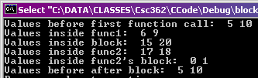
Scope Example with Blocks
#include <stdio.h>
void func1(int, int);
void func2(int, int);
void main()
{
int x = 5, y = 10;//main x, main y
printf("Values before first function
call: %d %d\n", x, y);
func1(x, y);// 5, 10
{
int x = 15, y = 20;//anym x, anym y
printf("Values inside
block: %d %d\n", x, y);
func2( x, y);15, 20
}
printf("Values before after block:
%d %d\n", x, y);
}
void func1(int x, int y)
{
x++; y--;
printf("Values inside func1:
%d %d\n", x, y);
}
void func2(int x, int y)
{
x+=2; y-=2;
printf("Values inside func2:
%d %d\n", x, y);
{
int a = 0, b = 1;
printf("Values inside func2's
block: %d %d\n", x, y);
}
//a++;
}
Notes:
The above example is silly. No one would ever do this. It just illustrates scope.

Slide 33
x | 5 | main
y | 10 | main
x | 6 | func1
y | 9 | func1
x | 15 | anonym
y | 20 | anonym
x | 17 | func2
y | 18 | func2

Slide 34
Variable Scope
GLOBAL SCOPE const int taxrate
Function Scope {Int x,g,h V=9 b=0} |  | Function Scope Int x, a, b taxrate=10
Block Scope{ Int a} | Block Scope | Block Scope{int c}
Local
Each scope sets the boundary . Each variable in a scope has separate memory.
Variable outside the boundary are not visible or useable .

Slide 35
Overlapping Names
/* Avoid Variables of the Same Name * lifetime.c */
#include <stdio.h>
void foo(int x)
{
int i = 4;
do {
int x = i;
printf("%d ", x); // Which value will print?
i--;
} while(i > 0);
printf("%d ", x); //which value will print?
}
int main(void) { foo(6); return 0; }
Notes:
Header files are usually not necessary, merely a convenience. For program #2, you will break your functions into several files and use a header file just to get the experience.

Slide 36
Header Files
In order to call upon functions compiled in separate files, you need to include their definition as a declaration or a prototype
for simplicity, if you have functions in several files, each of which call upon some of the same functions, you can place the prototypes in a single file, called a header file
all other shared definitions and declarations can go here as well
A header files typically only contain definitions and declarations, not executable code
Consider Assignment1 now . Contact.h consist of functions prototype only .
Contact.c is module that consist of definitions of all the functions of .h
Notes:
Header files are usually not necessary, merely a convenience. For program #2, you will break your functions into several files and use a header file just to get the experience.

Slide 37
Reference
All the material is taken from following
https://www.unf.edu/cop2220/phigbee/higbee_lectures/
Richard Fox , Northern Kentucky University
http://sappho.nku.edu/~foxr/home.html

